Slide 1

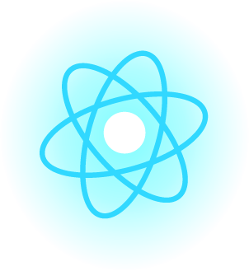



Programming Paradigms

Slide 2
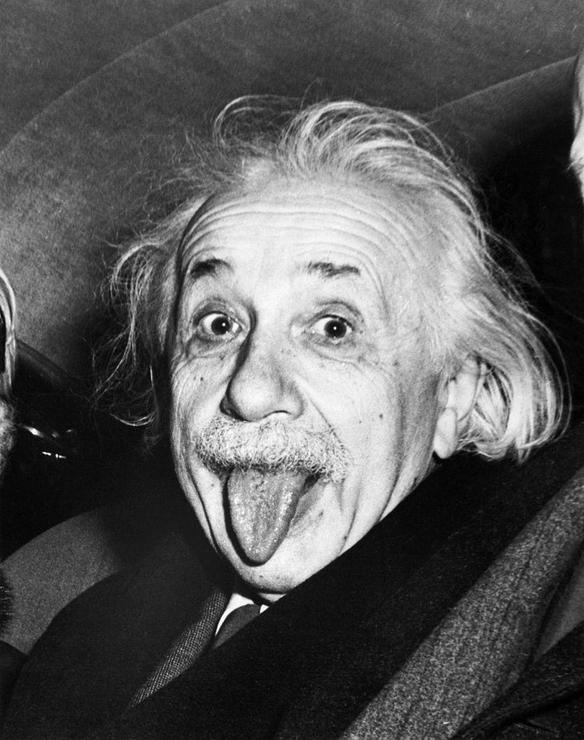
Imagination is Important than Knowledge.
Albert Einstein

Slide 3

Hello Everyone!
I am Abilov Jeyhun
I am here because I want to explain to you what is Programming Paradigms

Slide 4

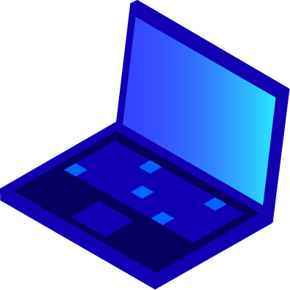

What is Programming Paradigm ?

Slide 5
Programming paradigms are different ways or styles in which a given program or programming language can be organized. Each paradigm consists of certain structures, features, and opinions about how common programming problems should be tackled.
The question of why are there many different programming paradigms is similar to why are there many programming languages.
Also, the practices that make up each paradigm have developed through time. Thanks to advances both in software and hardware, different approaches have come up that didn’t exist before.

Slide 6
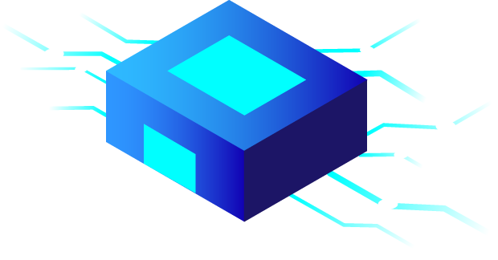
What a Programming Paradigm is NOT!

Slide 7
Programming paradigms are not languages or tools. You can’t “build” anything with a paradigm. They’re more like a set of ideals and guidelines that many people have agree on, followed, and expanded upon.
Programming languages aren’t always tied to a specific paradigm. There are languages that have been built with a certain paradigm in mind and have features that kind of programming more than others
(Haskel and functional programming is a good example).
But there are also “multi-paradigm” languages, meaning you can adapt your code to fit a certain paradigm or another (JavaScript and Python are good examples.

Slide 8
Why Should I care?
Short answer: general knowledge.
Long answer:
I find that it’s interesting to understand the many ways in which programming can be done. Exploring these topics is a good way of opening your mind and helping you think outside the box and outside the tool you already know. Moreover, these terms are used a lot in the coding world, so having a basic understanding will help you better understand other topic as well.

Slide 9
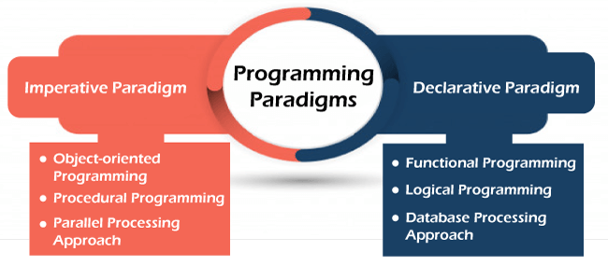

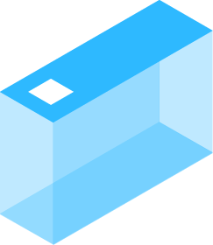
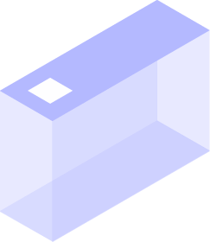
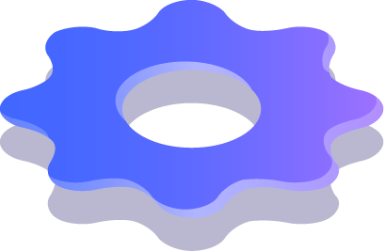
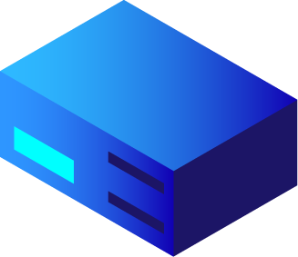

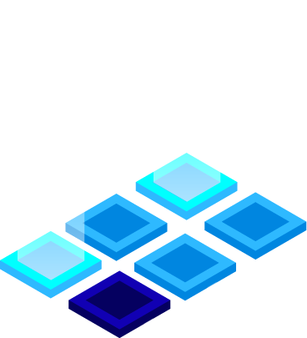


Slide 10
Imperative Programming
Imperative programming consists of sets of detailed instructions that are given to the computer to execute in a given order. It’s called “imperative” because as programmers we dictate exactly what the computer has to do, in a very specific way.
Imperative programming focuses on describing how a program operates, step by step

Slide 11
Procedural Programming
Procedural programming is a derivation of imperative programming, adding to it the feature of functions (also known as “procedures” or “subroutines”).
In procedural programming, the user is encouraged to subdivide the program execution into functions, as a way of improving modularity and organization

Slide 12
Functional Programming
Functional programming takes the concept of functions a little bit further.
In functional programming, functions are treated as first-class citizens, meaning that can be assigned to variables, passed as arguments, and returned from other functions.
Another key concept is the idea of pure functions. A pure function is one that relies only on its inputs to generate its result. And given the same input, it will always produce the same result.
Besides, it produces no side effects
(any change outside the function’s environment).

Slide 13
Declative Programming
Declative programming is all about hiding away and bringing programming languages closer to human language and thinking.
It’s the direct opposite of imperative programming in the sense is that the programmer doesn’t give instructions about how the computer should execute the task, but rather on what result is needed.

Slide 14
Object-Oriented Programming
One of the most popular programming paradigms is Object-Oriented programming.
The core concept OOP is to separate concerns into entities which are coded as objects. Each entity will group a given set of information (properties) and actions (methods) that can be performed by the entity.
OOP makes heavy usage of classes (which are a way of creating new objects starting out from a blueprint or boilerplate that the programmer sets). Objects that created from a class are called instances.

Slide 15
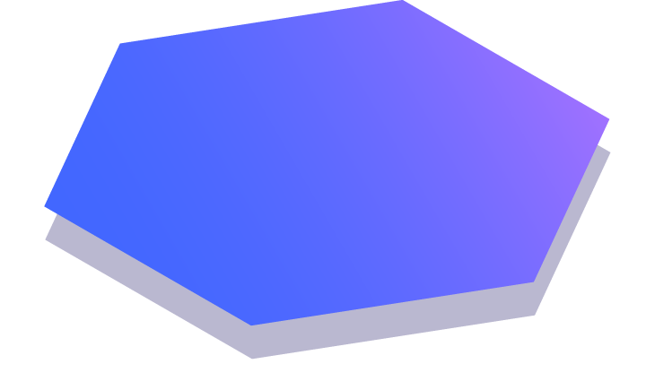
Thanks!
Any questions?

